Slide 1

Rust
Waterford Tech Meetup January 2025

Slide 2

So, what are we going to talk about?
What is Rust and where did it come from?
Why is Rust so closely tied to memory safety?
What is memory safety?
How does Rust help with memory safety?
Who’s using Rust?

Slide 3

What?
Photographer - David Bergin

Slide 4
Rust
fn main() {
println!("Hello, world");
}

Slide 5
Rust or Rusty?

Slide 6
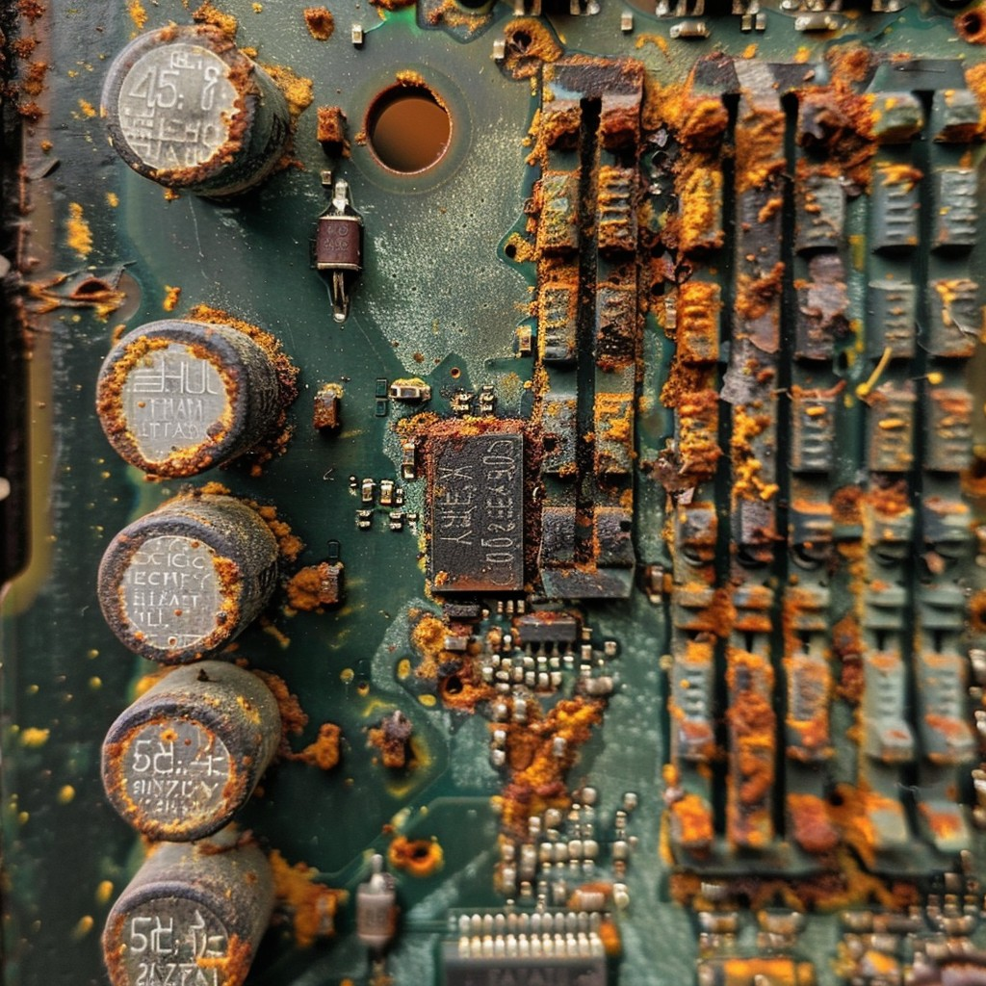
Rusty
Photo by Stockcake

Slide 7
Rust Ownership
fn main() {
let s = String::from("hello");
// we pass s to another function
takes_ownership(s);
println!("{s}");
}
fn takes_ownership(some_string: String) {
println!("{some_string}");
}

Slide 8

Rusty

Slide 9
Rust Borrowing
fn main() {
let s1 = String::from("hello");
let len = calculate_length(&s1);// & HERE!
println!("The length of '{s1}' is {len}.");
}
fn calculate_length(s: &String) -> usize { // & HERE!
s.len() // rust automatically dereferences
}

Slide 10
Rusty
Cop on John!

Slide 11
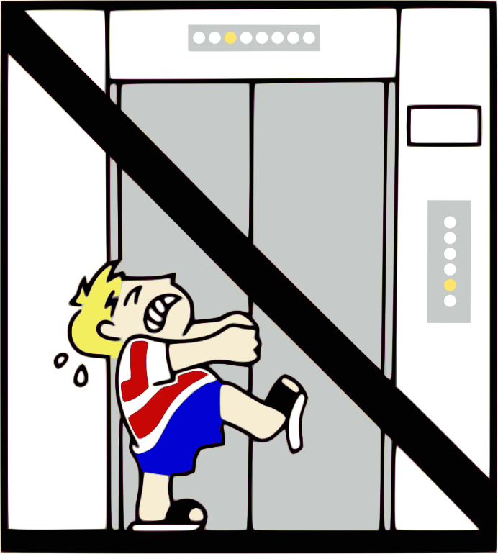


Alright, Seriously… What is Rust?
Notes:
In 2006,Graydon Hoare was a 29-year-old computer programmer working for Mozilla
Returning home to his apartment in Vancouver, he found that the elevator was out of order; its software had crashed.
This wasn’t the first time it had happened, either.

Slide 12
Walking to the 21st Floor Graydon Pondered…
I know what I’ll do, I’ll create a new programming language and name it Rust after a fungi that is overengineered for survival!!
It was probably another bug with memory management!
I wonder if the elevator code was written in C?
We computer people
couldn’t even make an elevator that works
without crashing

Slide 13

Rust was born as a…
A general purpose programming language built for performance, reliability and productivity.

Slide 14
Rust is…
Typically referred to as a systems level programming language with an emphasis on memory safety

Slide 15
Systems Programming?
Low-level software that interacts closely with hardware, such as operating systems, drivers, networking stacks, and embedded systems.
Requires high performance, precise control over resources, and efficient memory management, making them critical for infrastructure and performance-sensitive applications.

Slide 16
Systems Programming?
Assembly
Used for hardware-level programming but lacks abstraction and portability.
C
Known for its low-level control and performance but prone to memory safety issues.
C++
Adds object-oriented features to C but retains similar risks of unsafe memory usage.
Go
Focused on simplicity and concurrency but lacks Rust's fine-grained control over memory.

Slide 17
Rust and Cargo Demo? (maybe some pattern matching??)

Slide 18

So….. Memory…..

Slide 19

We need to talk….
About the stack and the heap…
We got this!

Slide 20
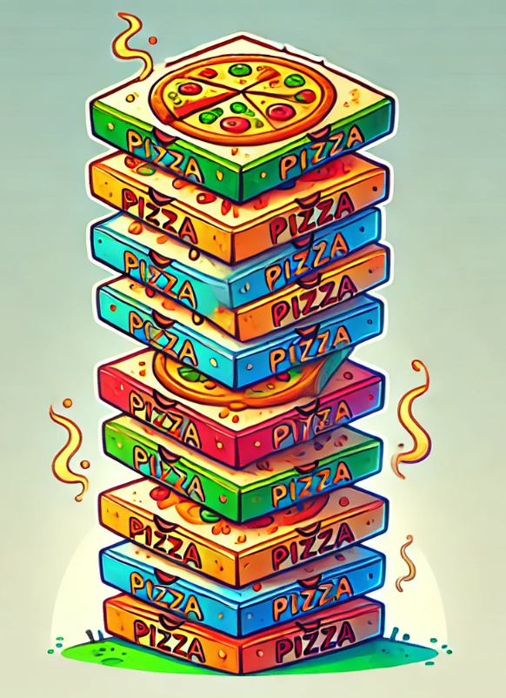
What is the stack and what is heap? – The stack
Both the stack and the heap are parts of memory available to your code to use at runtime, but they are structured in different ways
The stack stores known, fixed size data such as integers, booleans and characters
The stack is last in, first out, pushing to add and popping to remove
Working with the stack is very fast!

Slide 21
add()
fn main() {
let first = 22;
let second = 33;
let sum = add(first, second);
println!("the sum of of {first} and {second} are {sum}");
}
fn add(a: i32, b: i32) -> i32 {
return a + b;
}
a – i32 | 22
b – i32 | 33
return address | 0x23f
main()
first – i32 | 22
second – i32 | 33
sum – i32 | ?

Slide 22

The Heap
Think of the heap as a less organised “space” of data
Data with an unknown size at compile time or a size that might change must be stored on the heap.
A pointer to the data on the heap is stored on the stack

Slide 23
The Heap
Imagine you want to park a car of a certain size
You ask the attendant to allocate a space, store (park) your car
The attendant gives you a ticket that points to where your car is that you can use to retrieve your car
Or a pointer to retrieve the data

Slide 24
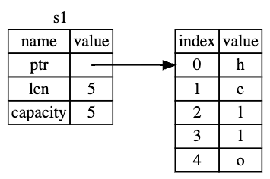
// a string could be retrieved from input
// so undefined size at compile time
let s1: String = String::from("hello");

Slide 25

What is memory safety?
#include <stdio.h>
int main(){
int initial_value = 60;
int items[5] = {1,2,3,4,5};
printf("initial value is %d\n", initial_value);
}

Slide 26
What is memory safety?
#include <stdio.h>
int main(){
int initial_value = 60;
int items[5] = {1,2,3,4,5};
printf("initial value is %d\n", initial_value);
}
Output: initial value is 60

Slide 27
What is memory safety?
#include <stdio.h>
int main(){
int initial_value = 60;
int items[5] = {1,2,3,4,5};
items[5] = 6; // put one too many in items
printf("initial value is %d\n", initial_value);
}

Slide 28
What is memory safety? (-fno-stack-protector)
#include <stdio.h>
int main(){
int initial_value = 60;
int items[5] = {1,2,3,4,5};
items[5] = 6; // put one too many in items
printf("initial value is %d\n", initial_value);
}
Output: initial value is 6, instead of 60 This all happens on the stack!

Slide 29
What is memory safety? (-fno-stack-protector)
To make this happen, we have to disable compile time protections
It is a simple example to illustrate how lower level languages can open doors to bugs

Slide 30
Dynamic memory allocation
int main() {
// Dynamically allocate memory for an array of 10 integers
// This all happens on THE HEAP
int *ptr = (int *)malloc(10 * sizeof(int));
if (ptr == NULL) {
printf("Memory allocation failed\n");
return -1;
}
// Populate the allocated memory
for (int i = 0; i < 10; i++) {
ptr[i] = i;
printf ("%d", ptr[i]);
}
// Forget to free the allocated memory?
free(ptr); // <-- If this line is missing, causing a MEMORY LEAK
ptr = NULL; // if this line is missing, causes DANGLING POINTER
return 0;
}

Slide 31
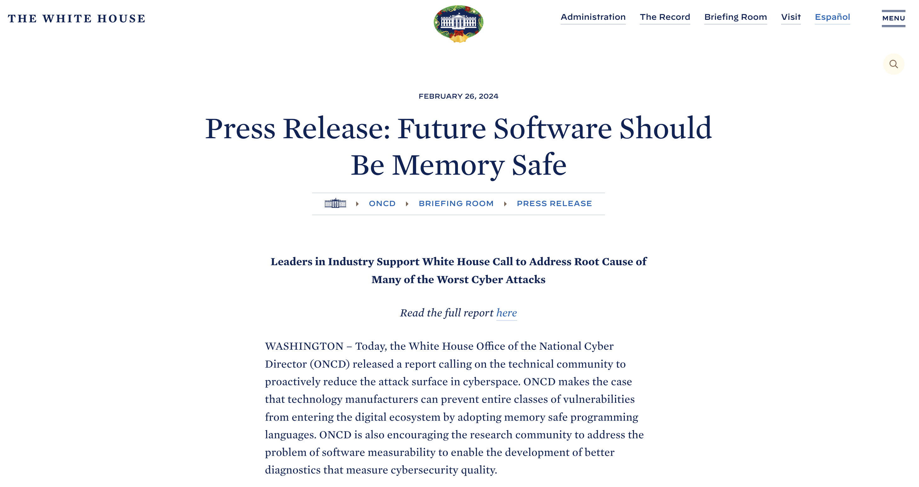
“Some of the most infamous cyber events in history – the Morris worm of 1988, the Slammer worm of 2003, the Heartbleed vulnerability in 2014, the Trident exploit of 2016, the Blastpass exploit of 2023 – were headline-grabbing cyberattacks that caused real-world damage to the systems that society relies on every day. Underlying all of them is a common root cause: memory safety vulnerabilities.”

Slide 32

Come again?
Rust is a systems programming language
It was created with reliability and performance at it’s core
One of the main facets of this reliability is memory safety
We have 2 areas of memory where we are concerned
The Stack and the Heap
Dynamic allocation of memory can cause issues such as:
Memory leaks when forgetting to free memory
Dangling pointers when we forget to nullify pointers
Not mentioned: multiple pointers attempting to access data at once can cause “data races”, more on these later
Even the White House is worried, so what makes more memory safe?

Slide 33
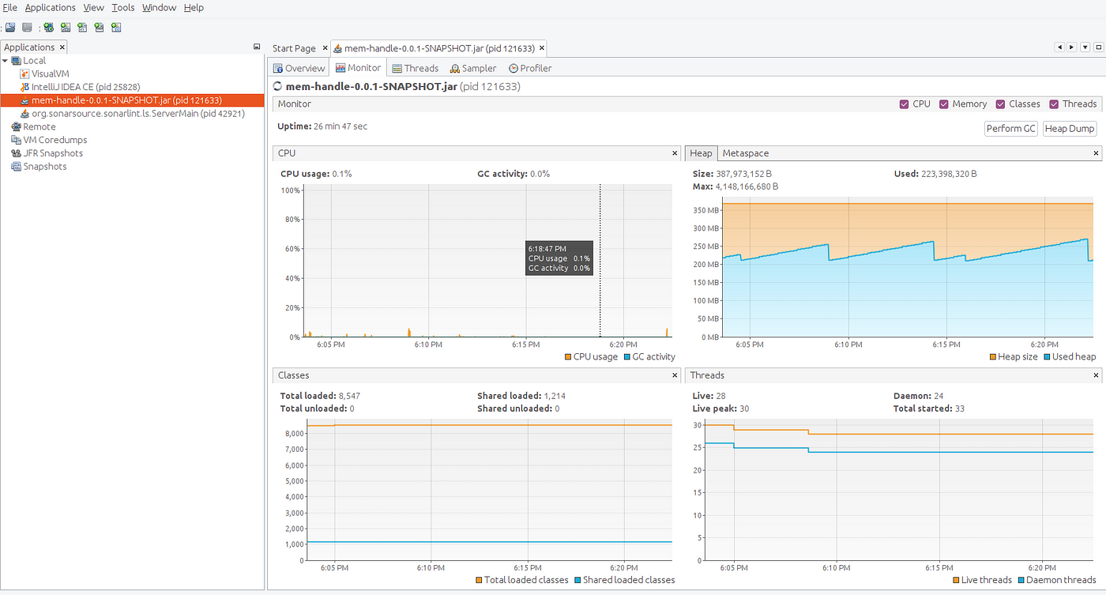
Well to improve performance, Rust does not use Garbage Collection to manage memory. (This is also to enable memory restricted use cases)

Slide 34

Rust has… Ownership!

Slide 35
Ownership is a set of rules that govern how a Rust program manages memory
Each value in Rust has an owner.
There can only be one owner at a time.
When the owner goes out of scope, the value will be dropped and memory freed
We will be introduced to the idea of MOVE and BORROW
fn main(){
let s1 = String::from("hello");
let s2 = s1;
println!("{s1}, world");
}
Consider the above, if coming from Java or JavaScript we might expect the output to be “hello, world”.
However if we compile…..

Slide 36
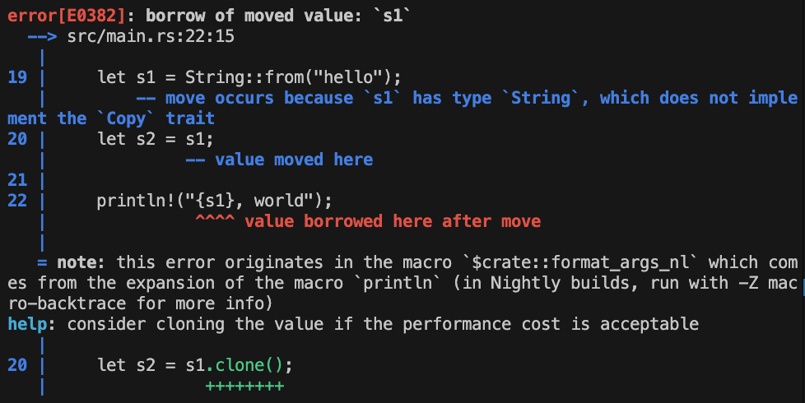
fn main(){
let s1 = String::from("hello");
let s2 = s1;
println!("{s1}, world");
}
This is compiler output!!!

Slide 37
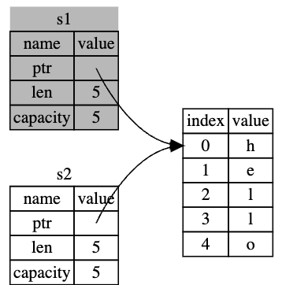
fn main(){
let s1 = String::from("hello");
let s2 = s1;
println!("{s1}, world");
}
The compiler throws an error because we’ve moved OWNERSHIP from s1 to s2 and then attempted to us s1 after that.
This is similar to a shallow copy, that is copying the pointer, length, and capacity without copying the data.
But because Rust also invalidates the first variable, instead of being called a shallow copy, it’s known as a MOVE.

Slide 38
fn main(){
let s1 = String::from("hello");
let s2 = s1;
println!("{s1}, world");
}
This is the a rule of ownership, a value on the heap can only have one owner
This prevents us creating multiple references to objects on the heap, thus reducing the possibility of a memory leak

Slide 39

This gets even weirder with functions
Well, weird, from a certain point of view

Slide 40
fn main() {
let s = String::from("hello");
// we pass s to another function
takes_ownership(s);
println!("{s}");
}
fn takes_ownership(some_string: String) {
println!("{some_string}");
}

Slide 41
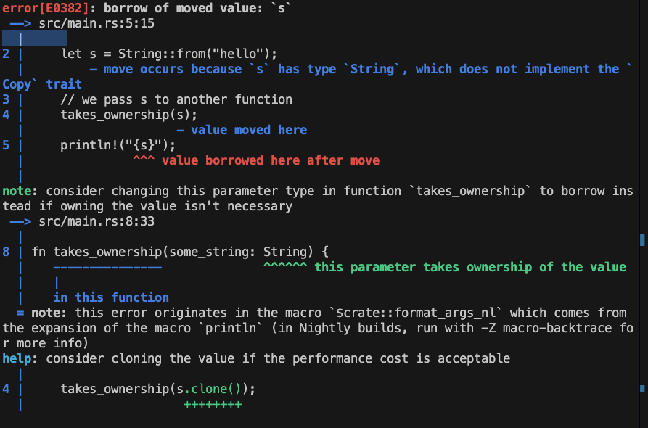
fn main() {
let s = String::from("hello");
// we pass s to another function
takes_ownership(s);
println!("{s}");
}
fn takes_ownership(some_string: String) {
println!("{some_string}");
}
Again, this is compiler output

Slide 42
fn main() {
let s = String::from("hello");
// we pass s to another function
takes_ownership(s);
println!("{s}");
}
fn takes_ownership(some_string: String) {
println!("{some_string}");
}
We are transferring OWNERSHIP of “s” to the function we are calling When that function ends, ”s” is DROPPED as it’s new owner is no longer in scope, even though it is still in scope in main.

Slide 43

So, we can’t pass a variable to a function and use it afterwards?

Slide 44

References and Borrowing
We must create a REFERENCE and pass that to our function
And use this REFERENCE to BORROW
We can create a reference using &

Slide 45
fn main() {
let s1 = String::from("hello");
let len = calculate_length(s1);
// will get same error here println!("The length of '{s1}' is {len}.");
}
fn calculate_length(s: String) -> usize {
s.len()
}
Passing a reference does not change ownership
fn main() {
let s1 = String::from("hello");
let len = calculate_length(&s1);// & HERE!
println!("The length of '{s1}' is {len}.");
}
fn calculate_length(s: &String) -> usize { // & HERE!
s.len() // rust automatically dereferences
}

Slide 46
fn main() {
let s1 = String::from("hello");
let len = calculate_length(&s1);// & HERE!
println!("The length of '{s1}' is {len}.");
}
fn calculate_length(s: &String) -> usize { // & HERE!
s.len() // rust automatically dereferences
}
We call the action of creating a reference BORROWING
We cannot edit what we have borrowed, well we can but not without making changes, but first….

Slide 47
Recap
Rust enforces a single owner on data stored in the heap
Reassigning, s2=s1, will MOVE and change ownership, invalidating the original owner
This ensures we have no dangling REFERENCES causing memory leaks
The Rust compiler impressively protects both the stack and the heap
We can use REFERENCES to BORROW a value in another function
However, these references are immutable!

Slide 48

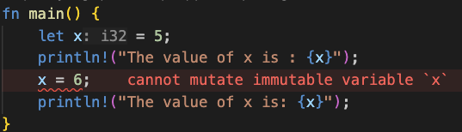
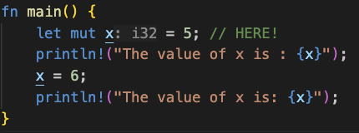
Immutability
Rust enforces immutability by default, that is, you cannot change, for example, the value of a variable
We need to intentionally define a variable as mutable, that is, we can change the value of the variable

Slide 49
Mutable References
References are immutable by default, so the following would throw a compile error
fn main() {
let mut s = String::from("hello");
change(&s);
}
fn change(some_string: &String) {
some_string.push_str(", world");
}

Slide 50
Mutable References
To allow editing of our value via reference, we can use mutable references
fn main() {
let mut s = String::from("hello");
change(&s);
}
fn change(some_string: &String) {
some_string.push_str(", world");
}
fn main() {
let mut s = String::from("hello");
change(&mut s);
}
fn change(some_string: &mut String) {
some_string.push_str(", world");
}

Slide 51
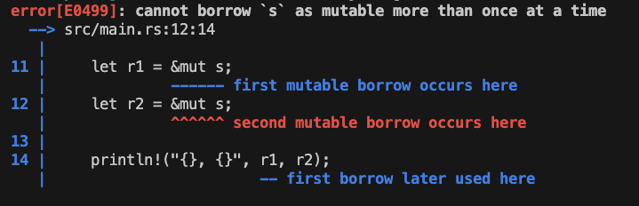
Mutable References
BUT, we cannot have more than 2 simultaneous mutable references AND the compiler enforces this:
fn main() {
let mut s = String::from("hello");
let r1 = &mut s;
let r2 = &mut s;
println!("{}, {}", r1, r2);
}

Slide 52
Mutable References
Disallowing multiple simultaneous references solves our last (for today…) memory safety concern, data races
A data race is similar to a race condition and happens when these three behaviours occur:
Two or more pointers access the same data at the same time.
At least one of the pointers is being used to write to the data.
There’s no mechanism being used to synchronize access to the data.
Data races cause undefined behavior and can be difficult to diagnose and fix when you’re trying to track them down at runtime

Slide 53
Recap
We’ve seen how the rust compiler can prevent numerous memory safety concerns at compile time, even when dealing with dynamically allocated memory in the heap
That was a slog, some easy slides

Slide 54
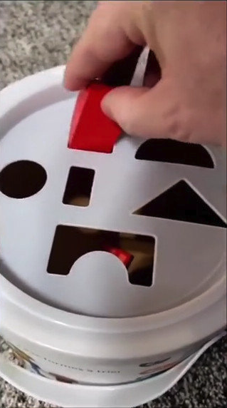
Pattern Matching and enums????
Match first, maybe with coins or something else.
Just use enums
The option enum, null the billion dollar mistake
The result enum and pattern matching
Pattern matching errors
unwrap

Slide 55
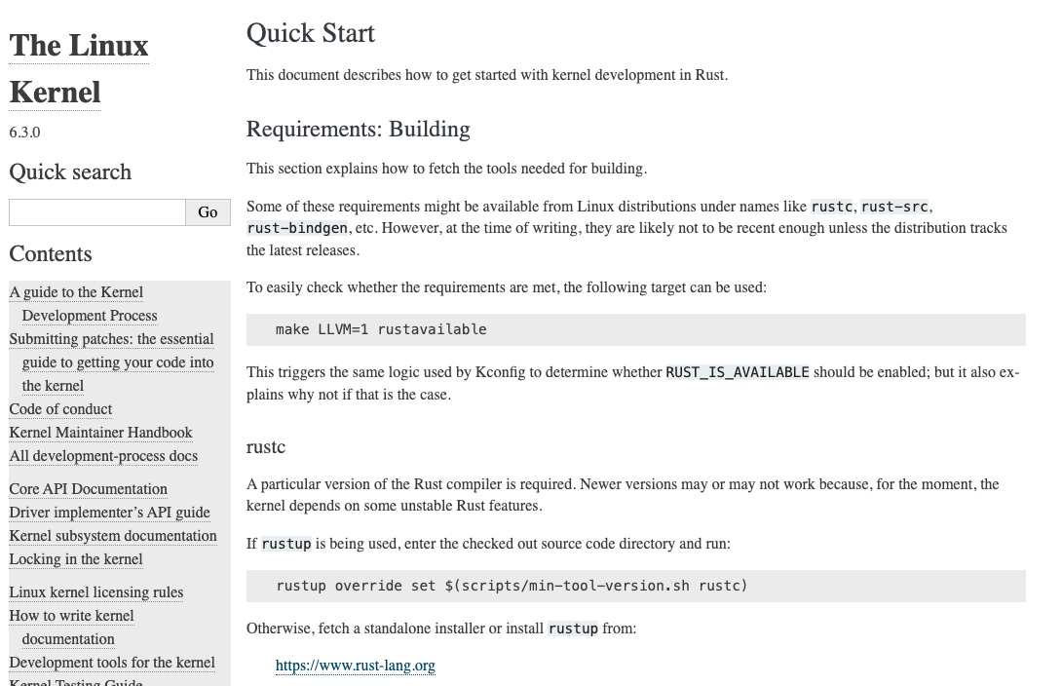
Who is using rust? The Linux Kernal

Slide 56

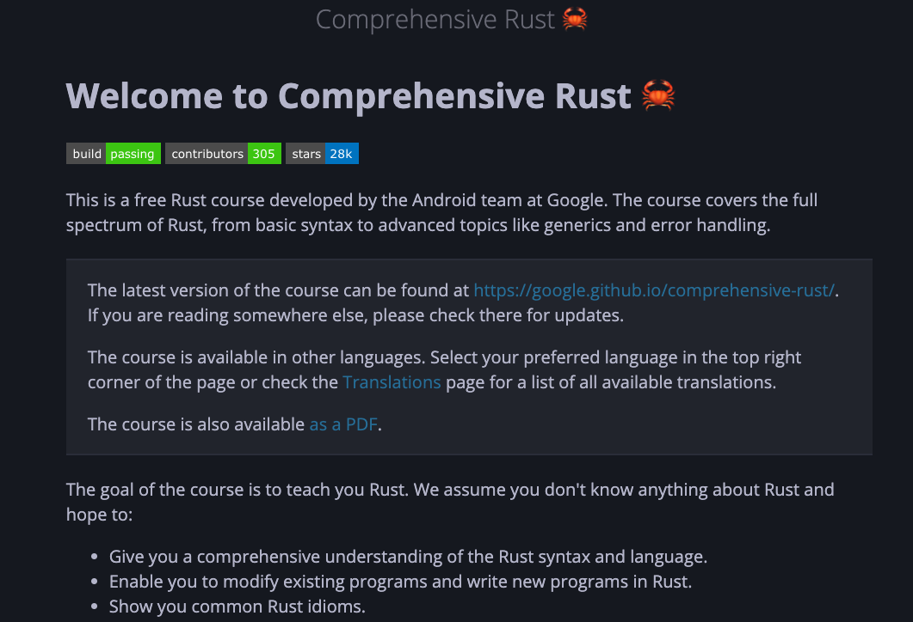
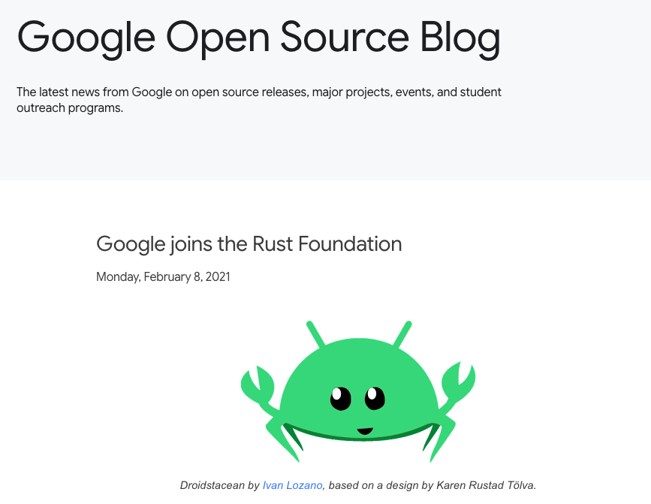
Who is using rust? Google
At Google, we have been seeing increased Rust adoption, especially in our consumer applications and platforms
https://google.github.io/comprehensive-rust/

Slide 57
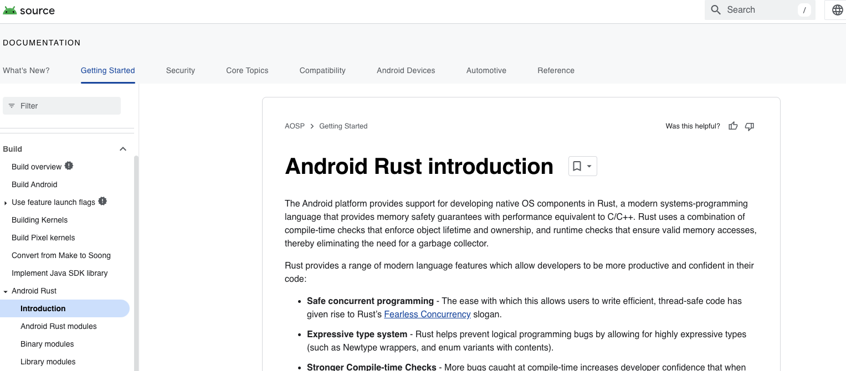
Who is using rust? Android
The transition to memory-safe languages such as Rust as part of its secure-by-design approach has led to the percentage of memory-safe vulnerabilities discovered in Android dropping from 76% to 24% over a period of six years.

Slide 58



Who is using rust? AWS

Slide 59
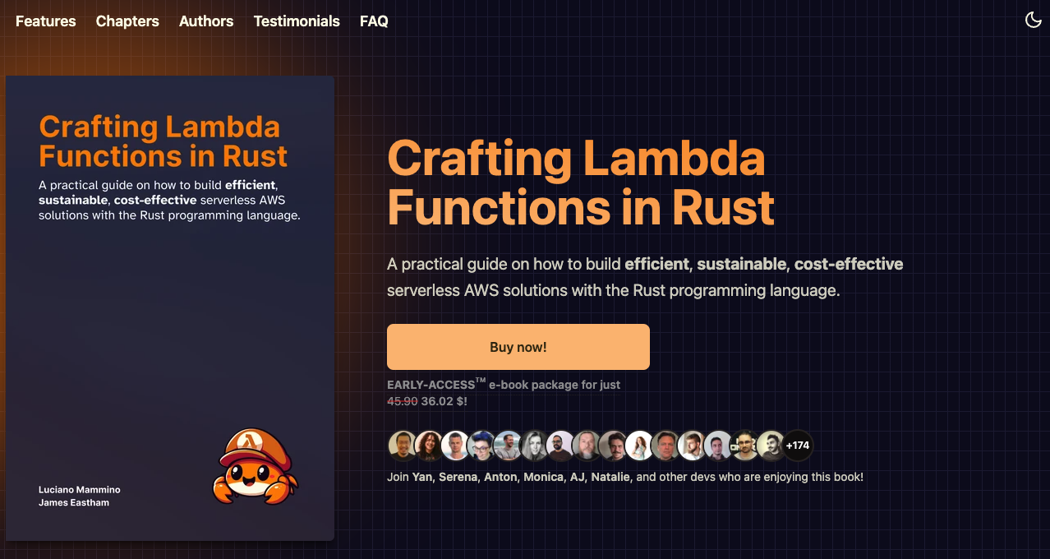
Who is using rust? YOU, in lambda ;)
https://rust-lambda.com/

Slide 60
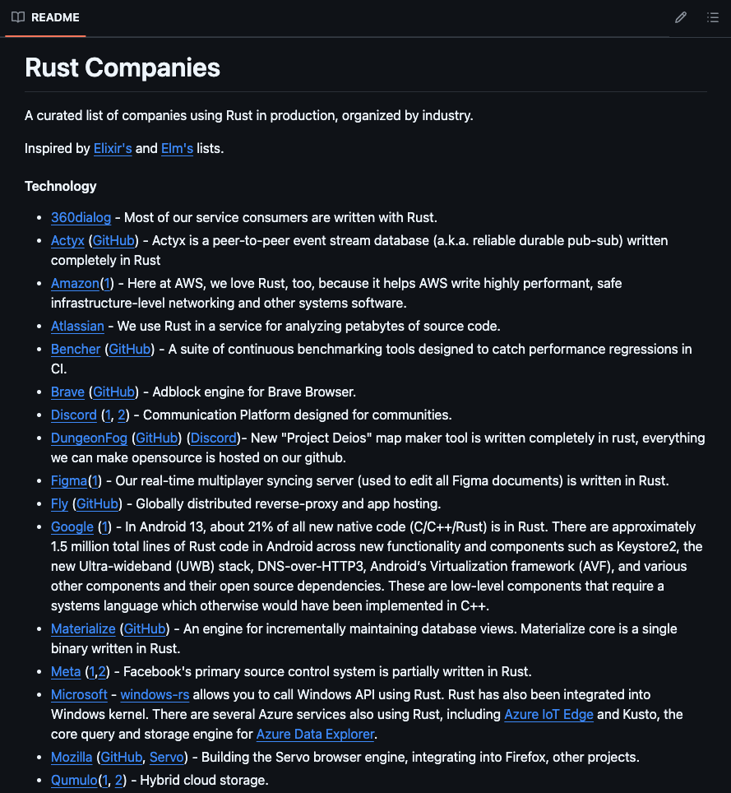
Who is using rust? More
https://github.com/omarabid/rust-companies

Slide 61
So, should I use rust in my company?
Do you have a use case?

Slide 62

Questions? (or beer?)

Slide 63
Who is using rust
Linux kernal
Loads of google
Firecracker microvms on AWS
Lambdas
DARPA?

Slide 64
Ownership
double free error
Shallow copy in other languages is a MOVE in rust
s2 = s1 will set s2 to the pointer of s1 in other languages
in rust, the pointer is moved from s2 to s1 and s1 now becomes invalid
Rust will never automatically create a deep copy, use clone
Rust will clear up memory the immediately after a string value is assigned a new value, DROP() is called on the initial value immediately
Much more concise than scope based lifecycling
num2 = num1 is a copy of the value and is on the stack as it is of a known size
There is a copy trait, as is drop, rust wont allow the 2
ownership-and-functions example
Transferring ownership in this way could be tedious, so we look at references and borrowing

Slide 65
References and borrowing
Unlike a pointer, a reference is guaranteed to point to a valid value of a particular type for the life of that reference. (will never be dangling)
References will never be dangling pointers
Can point
Can pass mutable references to functions
Rust prevents 2 mutable references to prevent data races AT COMPILE TIME
At any given time, you can have either one mutable reference or any number of immutable references.
References must always be valid.

Slide 66
The slice type
Slices let you reference a contiguous sequence of elements in a collection rather than the whole collection. A slice is a kind of reference, so it does not have ownership.
Don’t think we need to do this for the presentation

Slide 67
lifetimes

Slide 68
Tractor?

Slide 69
Macros

Slide 70
Cargo? Rustup?

Slide 71
Simple slide on OO using structs?

Slide 72
Rust is all about empowerment

Slide 73
Should I/my company use rust?

Slide 74
Unsafe rust

